Slide 1
Driver Onboarding System
Presented By : Debarati Ray
Date : 24/07/2023

Slide 2

INTRODUCTION

Slide 3
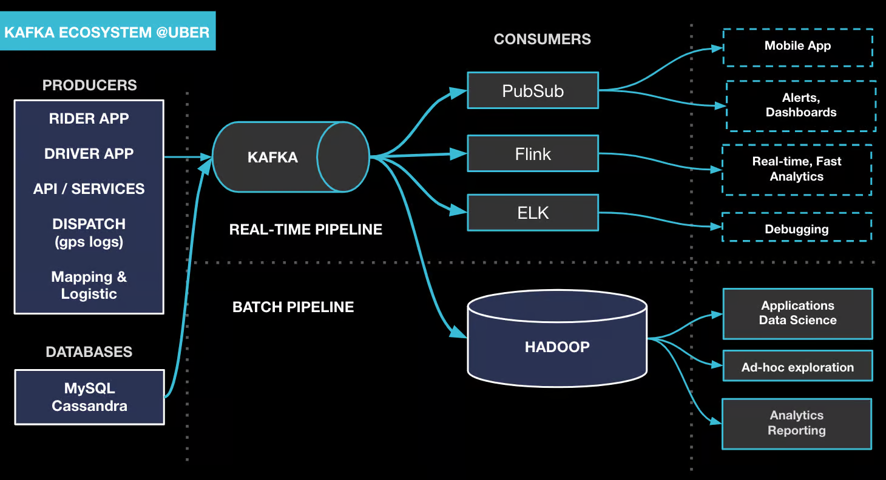
DESIGN DIAGRAM

Slide 4



